Slide 1


Inheritance and Polymorphism in java
KVS CHARAN(T1735)
A Quest Global Company

Slide 2
1: What is Inheritance in java?
Inheritance is a fundamental concept in Java and object-oriented programming (OOP) that allows a child class to inherit the properties and behaviors of another class that is parent class.
This promotes code reusability and establishes a relationship between the parent and child classes.
Types of Inheritance
Single Inheritance: A subclass inherits from one superclass.
Multilevel Inheritance: A subclass is derived from another subclass.
Hierarchical Inheritance: Multiple subclasses inherit from a single superclass.
Multiple Inheritance: Java does not support multiple inheritance with classes directly, but it allows multiple inheritance through interfaces.

Slide 3
Key Concepts of Inheritance
Superclass (Parent Class)
The class that provides the properties and methods to the subclass.
It may have fields (variables) and methods (functions) that can be inherited by the subclass.
Subclass (Child Class)
The class that inherits the properties and methods from the superclass.
A subclass can add its own properties and methods, or override the methods inherited from the superclass.
extends Keyword
In Java, inheritance is implemented using the extends keyword. A subclass extends a superclass to inherit its properties and methods.
Access to Superclass Members
A subclass inherits public and protected members (fields and methods) of the superclass. However, it does not inherit private members.
You can access the superclass's members using the super keyword.

Slide 4
Important Terminologies Used in Java Inheritance
Class: Class is a set of objects which shares common characteristics/ behavior and common properties/ attributes. Class is not a real-world entity. It is just a template or blueprint or prototype from which objects are created.
Parent Class: The class whose features are inherited is known as a superclass(or a base class or a parent class).
Child Class: The class that inherits the other class is known as a subclass(or a derived class, extended class, or child class). The subclass can add its own fields and methods in addition to the superclass fields and methods.
Reusability: Inheritance supports the concept of “reusability”, i.e. when we want to create a new class and there is already a class that includes some of the code that we want, we can derive our new class from the existing class. By doing this, we are reusing the fields and methods of the existing class.

Slide 5
Child Class: The class that inherits the other class is known as a subclass(or a derived class, extended class, or child class). The subclass can add its own fields and methods in addition to the superclass fields and methods.
Reusability: Inheritance supports the concept of “reusability”, i.e. when we want to create a new class and there is already a class that includes some of the code that we want, we can derive our new class from the existing class. By doing this, we are reusing the fields and methods of the existing class.
Limitations of Inheritance
Tight Coupling: Inheritance can lead to tight coupling between the parent and child classes, making it harder to change the parent class without affecting the subclasses.
Multiple Inheritance: Java does not allow multiple inheritance with classes, which can limit flexibility. However, it can be achieved using interfaces.
Syntax
class Childclass extends Parentclass
{
//Methods
}

Slide 6
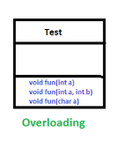
2: Polymorphism in java?
Polymorphism is one of the four core concepts of Object-Oriented Programming (OOP), the others being Encapsulation, Inheritance, and Abstraction.
In Java, polymorphism allows objects to be treated as instances of their parent class, with the ability to call overridden methods. The term polymorphism comes from Greek, meaning many forms.
Polymorphism enables Java developers to create more flexible and reusable code. Understanding when and how to use it can make your code more maintainable.
The Java Programming Course offers practical examples and projects that showcase the power of polymorphism in real-world applications.
Types of Polymorphism
Method overloading
Method overriding

Slide 7
Method Overloading
When there are multiple functions with the same name but different parameters then these functions are said to be overloaded. Functions can be overloaded by changes in the number of arguments or/and a change in the type of arguments.
Different Ways of Method Overloading in Java
Changing the Number of Parameters.
Changing Data Types of the Arguments.
Changing the Order of the Parameters of Methods

Slide 8
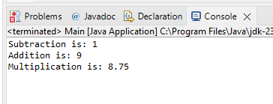
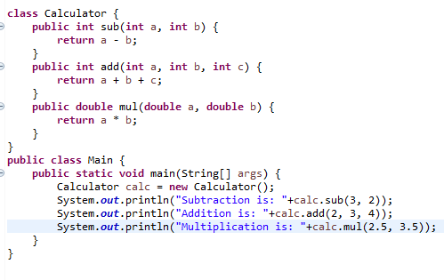
Method Overloading Code Output
Method Overloading Code

Slide 9
3: Java Method Parameters
Parameters are variables defined in the method declaration after the method name, inside the parentheses. This includes primitive types such as int, float, boolean, etc, and non-primitive or object types such as an array, String, etc.
We can pass values(Argument) to the method parameters, at the method call. The method call has the same number of arguments and is in the same order, as the parameters.
Java method parameters are vital part of Java. It allows the methods to take data and make them adaptable and versatile. Java method parameters act as inputs to methods, they enable the passing of information when the method is called. By using parameters, we can create methods that work with various data, we also can perform reusability and avoid hard−coding specific values.
Parameters help to improve the flexibility of the methods. It enables the same method to process different values and reduces the need for repeated code.
pass−by−value
pass-by-reference
Method without parameters

Slide 10
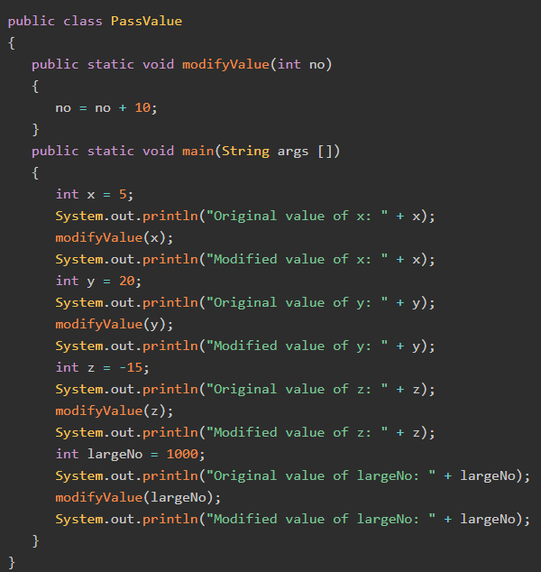
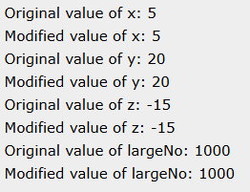
Output: code for pass-by-reference
code for pass-by-value

Slide 11
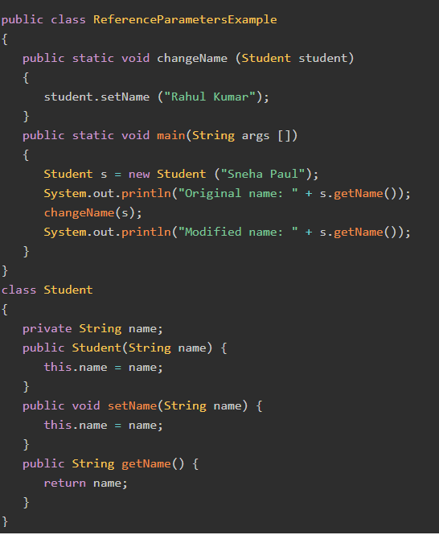

Output: code for pass-by-reference
code for pass-by-reference

Slide 12
Functions are a way to break a program into different modules which are executed one by one. To use a function in Java we need to:
Declare the function i.e. declare a prototype of the function.
Define the function
Call the function
Declaring, Defining and Calling a function

Slide 13
public class Main {
public static void greet()
{
System.out.println("Hey charan! Welcome to banglore");
return;
}
public static void main(String args[])
{ greet();
}
}
Output: Hey charan! Welcome to banglore

Slide 14
java methods on combining parameter and return type
public class Calculator {
public int add(int a, int b) {
return a + b; // Returns the sum of a and b
}
public static void main(String[] args) {
Calculator calc = new Calculator();
int result = calc.add(5, 10);
System.out.println("Sum: " + result); Outputs: Sum: 15
}
}

Slide 15
Types of Method Parameters
Primitive Type Parameters
Reference Type Parameters (Objects)
Varargs (Variable Arguments)
Primitive Type Parameters: These parameters represent basic data types such as int, float, double, char, boolean, etc. When passing primitive types to a method, the value is passed by value, meaning the method gets a copy of the value.
Reference Type Parameters: In Java, objects are passed to methods using reference types. When you pass an object to a method, the method gets a reference to the object, not a copy. This means changes made to the object inside the method will reflect on the original object.
Varargs (Variable Arguments): Java allows a method to accept a variable number of arguments of the same type, which is known as Varargs (variable-length arguments). This allows the method to be called with any number of arguments of that type.
Syntax
public void methodName(dataType... varargs)

Slide 16


